Slide 1
Scrum Values

Slide 2
Week 8 Summary Scrum breakdowns
Undefined Time Boxes
Optimizing for Sprints
Long, Lazy Standups
Work Interruptions
Loose Demos
Problem Solving During Retrospectives

Slide 3
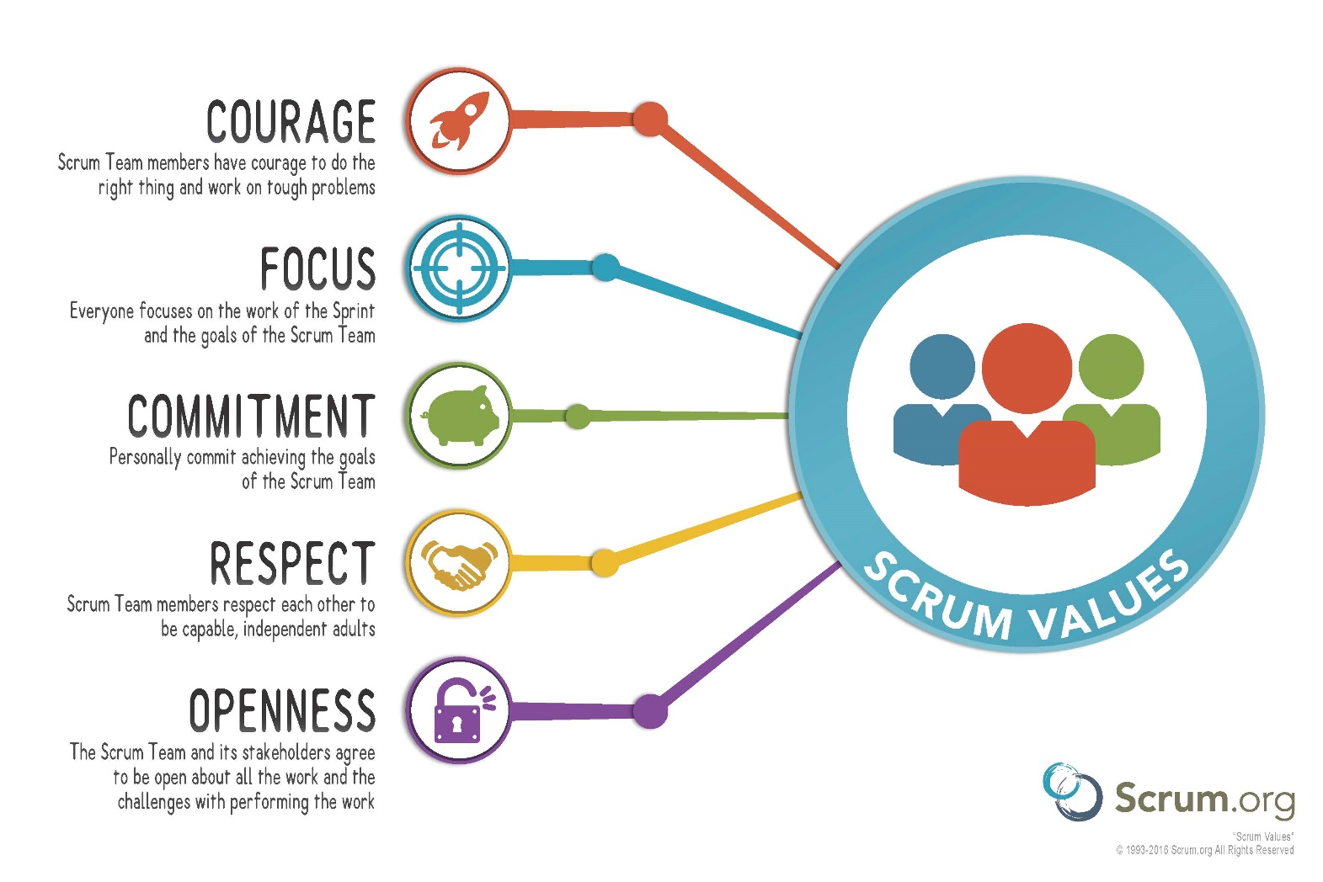
Week 9 Overview

Slide 4
Scrum Values important
For health of team
For success of team

Slide 5
Scrum Value 1: Focus
Because scrums focus on only a few things at a time, the team work well together and produce excellent work
Teams deliver valuable items sooner

Slide 6
Scrum Value 2: Courage
Because scrum work as a team, team members feels supported and have more resources at their disposal
This gives team the courage to undertake greater challenges

Slide 7
Scrum Value 3: Openness
As scrum team work together, team members express how they are doing, what's in their way, and their concerns so the concerns can be addressed

Slide 8
Scrum Value 4: Commitment
Because scrum teams have great control over their own destiny, they are more committed to success

Slide 9
Scrum Value 5: Respect
As scrum teams work together, sharing successes and failures, team members come to respect each other and to help each other become worthy of respect
As we work together, sharing successes and failures, we come to respect each other and to help each other become worthy of respect.

Slide 10
Activity
In your project group, identify when your scrum team has
withheld each of the scrum values (5 minutes)
violated each of the scrum values (5 minutes)
Each group present to the class (10 minutes)
Scrum Values
Focus
Courage
Openness
Commitments
Respect

Slide 11
Week 9 Summary

